Slide 1


Nassau County Office of Community Development
FY 2025 Public Hearing on Community Development and Housing Needs
January 28, 2025 – 2:00 PM
Bruce A. Blakeman
Nassau County Executive
Jeffrey M. Clark
Executive Director of Community Development

Slide 2
Agenda
Welcome and Overview of the Nassau Urban County Consortium
Five-Year Consolidated Plan
Fair Housing
CDBG Program
HOME Program
ESG Program
Section 3 and Other Federal Requirements
2025 Application Process
Public Comment on CDBG needs and housing needs

Slide 3
Nassau Urban County Consortium
Entitlement community under the U.S. Department of Housing and Urban Development’s Consolidation Programs
The Consortium receives annual allocations of funding under the following programs:
  Community Development Block Grant Program (CDBG)
  HOME Investment Partnerships Program (HOME)
  Emergency Solutions Grants Program (ESG)

Slide 4
Nassau County Consortium Member Municipalities
Towns (3)
Hempstead
North Hempstead
Oyster Bay
Villages (24)
Bayville
Bellerose
East Rockaway
East Williston
Farmingdale
Floral Park
Freeport
Great Neck Plaza
Hempstead
Island Park
Lynbrook
Malverne
Manorhaven
Massapequa Park
Mineola
New Hyde Park
Rockville Centre
Roslyn
Sea Cliff
South Floral Park
Stewart Manor
Valley Stream
Westbury
Williston Park
Cities (2)
Glen Cove
Long Beach

Slide 5
Five-Year Consolidated Plan

Slide 6
Five-Year Consolidated Plan
Collaborative Process aimed at identifying a unified vision for community development actions to be undertaken during the Five-Year Period, includes:
  Strategic Plan
    Analysis of data and needs
    Establishes priorities and goals for Five-Year Period
  Fair Housing Plan/Analysis of Impediments
  Annual Action Plan
    Activity/Project Information for Year 1

Slide 7
Five-Year Consolidated Plan
HUD Merged Separate Application/Funding Cycles into a More Coordinated Process
1st – FFY 1999 - 2004
2nd – FFY 2005 – 2009
3rd – FFY 2010 – 2014
4th – FFY 2015 – 2019
5th – FFY 2020 - 2024
6th – FFY 2025 - 2029

Slide 8
Five-Year Consolidated Plan
Meeting with various stakeholders to assess:
  Housing and community development needs
  Fair and affordable housing issues
  Series of meetings in November 2024

Slide 9
Five-Year Consolidated Plan
Housing Needs
  Affordable housing
  Housing authorities
  Homelessness needs
  Housing for special needs
Non-Housing Community Development Needs
  Infrastructure
    Pedestrian improvements
    Parks, open space
    Downtown revitalization
  Public Services
    Seniors
    Job training
    Mental health
    Youth
    Special needs
    Transportation
Fair Housing
  Barriers to affordable housing

Slide 10
Fair Housing

Slide 11
Fair Housing
Subrecipients and Contractors are responsible for implementing their projects in compliance with all local, state and federal laws and regulations regarding civil rights, fair housing and equal opportunity
Subrecipients or Contractors are required to actively enforce the provisions of such statutes and regulations and develop strategies for addressing the requirements
Subrecipients and Contractors must take affirmative steps to promote fair and equal access to housing without regard to race, color, religion, gender, age, national origin, disability, or familial status

Slide 12
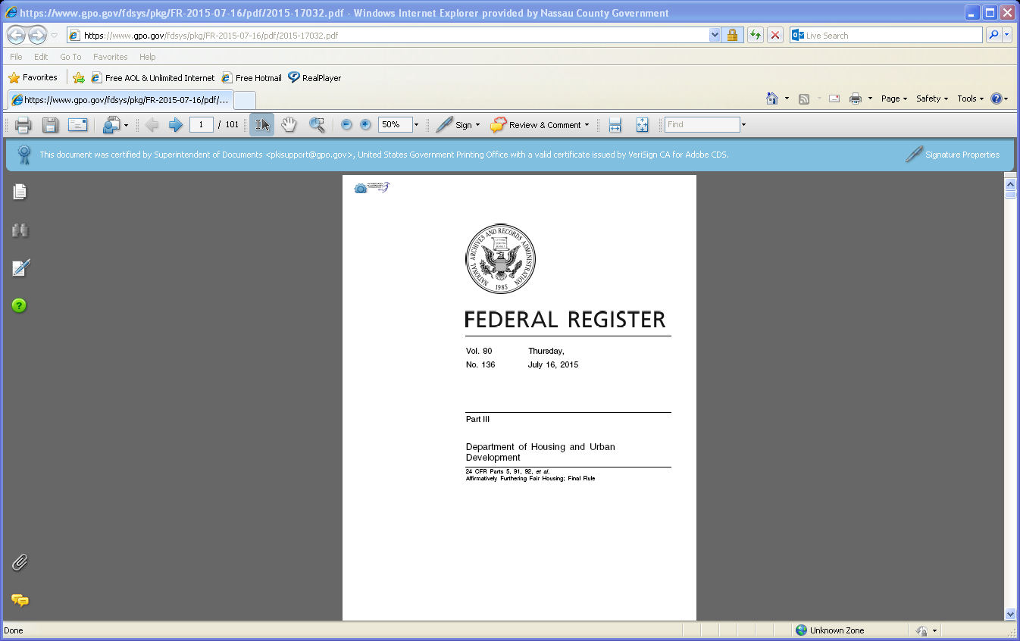
Affirmatively Furthering Fair Housing Rule
The AFFH rule sets out a framework for local governments, states, and public housing agencies (PHAs) to take meaningful actions to overcome historic patterns of segregation, promote fair housing choice, and foster inclusive communities that are free from discrimination (July 2015, June 2021).

Slide 13
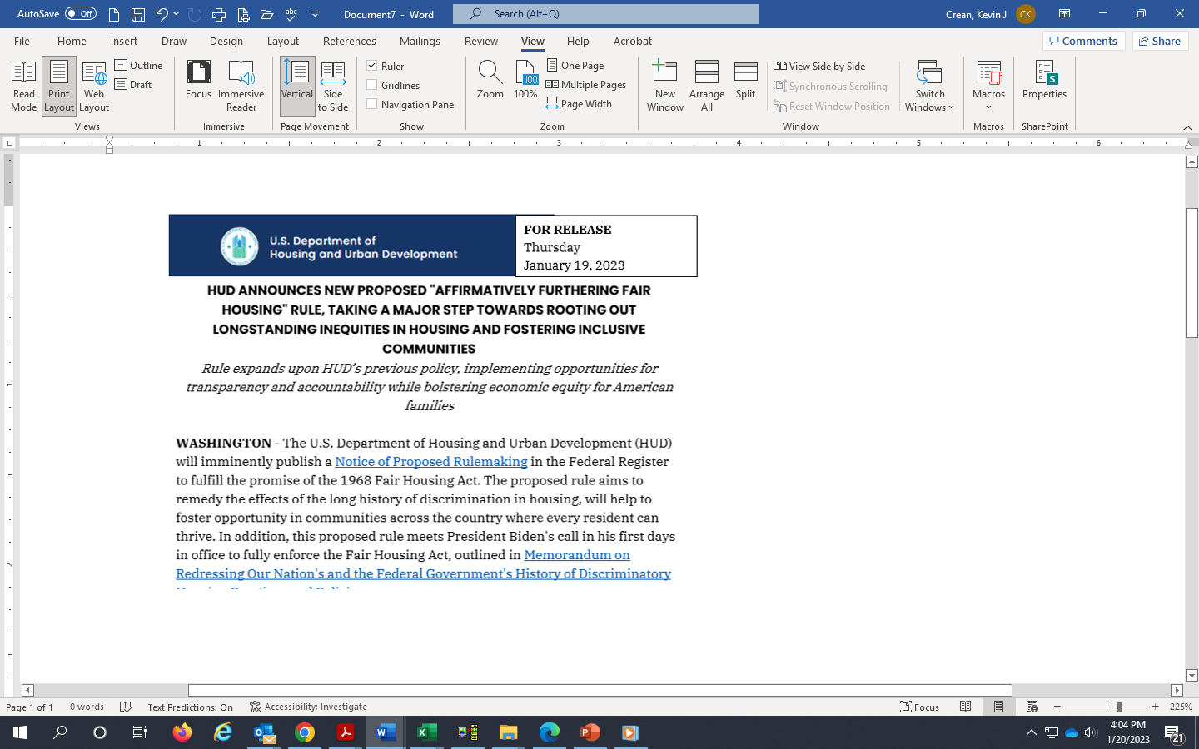
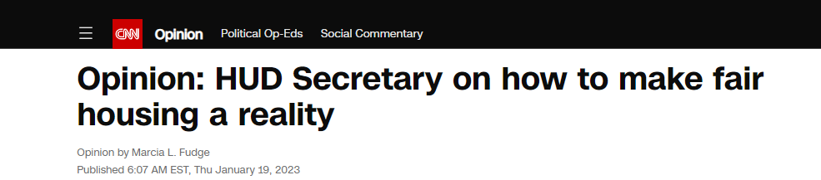
Affirmatively Furthering Fair Housing
January 2023 – HUD announces that it will soon publish a “Notice of Proposed Rulemaking on Affirmatively Furthering Fair Housing” that will refine the 2015 Affirmatively Furthering Fair Housing Rule.
Equity Plan would be due prior to next Five-Year Consolidated Plan.

Slide 14
Analysis of Impediments to Fair Housing Choice (AI)
Nassau County will submit a new Analysis of Impediments in FFY 2025 along with its Five-Year Consolidated Plan
The AI will Identify Impediments to Fair Housing Choice in the County and describe actions being taken to address the obstacles
CDBG, HOME & ESG funding applications are designed to collect information related to Affirmatively Furthering Fair Housing

Slide 15
Fair Housing
Application Questions: Does the Proposed Activity?
Support and promote integrated communities and improve integrated living patterns?
Reduce racially and ethnically concentrated areas of poverty?
Respond to identified disproportionate housing needs of persons protected under the Fair Housing Act?
Foster and maintain compliance with civil rights and fair housing laws?
Address disparities in access to key community assets which may provide greater mobility and access to vital assets including economic opportunities, employment, health, transportation and quality education?

Slide 16
Fair Housing Plan/Analysis of Impediments to Fair Housing Choice (“AI”)
Concurrently with the preparation of the Five-Year Consolidated Plan the County is preparing an update to its 2020 Analysis of Impediments to Fair Housing.
The Fair Housing Plan Update is being undertaken by Nassau County together with a Fair Housing Plan Committee consisting of key representatives from Nassau County Agencies, fair housing advocacy organizations, and other non-profit organizations

Slide 17
Fair Housing Plan/AI
The Fair Housing Committee has identified the following tentative list of Impediments to Fair Housing Choice in Nassau County:
  Discrimination in the Nassau County Housing Market
  Insufficient Understanding of “Reasonable Accommodations” and ADA Compliance
  Lending Policies, Practices and Disparities
  Extremely High Cost of Housing
  Community Planning and Zoning Decisions that Impede Affordable Housing
  Limited Availability of Funds
  Limited Non-Profit Capacity
  Abandoned/Deteriorating Housing
  Employment/Housing/Transportation Linkage

Slide 18
Fair Housing Plan/AI Identifies High Opportunity Areas (HOAs)
Very Low Poverty Rates
Very Low Unemployment Rate
High Levels of Completed College Among Adults
Low Concentration of Racial or Ethnic Minorities
High Performing Public Schools
Low Crime Rates
Access to Public Transportation and Employment
Affordable and mixed-income housing will be encouraged in High Opportunity Areas and HOME funds for projects in HOAs will be given high priority

Slide 19
Fair Housing Plan/AI
YOU can participate
The Nassau County Housing Survey is LIVE through March 31st, 2025
Available in English and Spanish
Take the Nassau County Survey NOW!
https://forms.office.com/r/bLck4J5Dea

Slide 20
Fair Housing Plan/AI
YOU can participate
Review and comment on:
Draft Fair Housing Plan
Expected to be issued on May 5, 2025
Followed by a 30-day comment period

Slide 21
Community Development Block Grant Program (CDBG)

Slide 22
Eligible Nassau County Priorities
CDBG
Eligible activities under the CDBG Program can be found in the regulations at 24 CFR 570.201 – 206. These activities include:
570.201
    Acquisition
    Disposition
    Public facilities and improvements
    Clearance activities
    Public services
    Payment of non-Federal share
    Relocation
    Housing services
    Homeownership assistance
    Micro enterprise assistance

Slide 23
CDBG Eligible Rehabilitation and Preservation Activities
570.202 Eligible Rehabilitation and Preservation Activities include:
  Residential Rehabilitation
  Commercial Rehabilitation
  Code enforcement
  Historic Preservation
  Renovation of closed buildings
  Lead-based paint activities

Slide 24
Social Economic Development
570.203 Special Economic Development
  Direct Assistance to Businesses
  Job Creation and/or Retention
  Primarily Benefit Low/Mod Persons
  Leveraging of CDBG funds

Slide 25
National Objective Compliance
Every activity under the CDBG Program must meet one of the three broad national objectives of the program
  Benefit to low- and moderate-income persons
  Prevention or elimination of slums and blight
  Meet a community need having a particular urgency

Slide 26
Activity Timeliness and Targeted Completions
In an effort to reduce the number of open activities, HUD is requiring more detailed project descriptions, project timelines, & completion date targets
Funding applications request this information
Any activity type that is currently flagged by HUD will not be awarded 50th program year funds unless a detailed remediation plan acceptable to HUD has been submitted

Slide 27
Timeliness Workout Plans
CDBG Funding Applications request status reports on prior funded activities
Any consortium member municipality that fails to meet the timeliness of expenditure targets by June 30th will be required to submit a detailed workout plan designed to bring its program into compliance by June 2025

Slide 28
2020 Census Updates
The Census Bureau has released the 2016-2020 American Community Survey (ACS) data
HUD has released low/moderate income data for the Nassau County Consortium based on the 2016-2020 ACS Census data
HUD has adjusted the exception criteria for CDBG low/moderate eligibility to 47.10%
Consortium Members are advised to confirm eligibility for area-benefit activities prior to requesting funds

Slide 29
HOME Investment Partnerships Program (HOME)

Slide 30
HOME Investment Partnerships Program
Severe cuts to program fundings:
  With the expected funding levels in FY 2025, funding is about 53.6% of FY 2010 funding
  Expected funding is roughly 51.5% of Nassau County’s Allocation from FY 2003

Slide 31
HOME Investment Partnerships Program
Final Rule Published July 24, 2013
Emphasis on
  Assessing risk of activities and projects;
  Monitoring performance and compliance;
  Stricter subsidy layering and underwriting guidelines;
  Assessment, at minimum, of:
    Market conditions of the neighborhood where project will be located;
    Housing development experience and financial capacity of developer; and
    Firm financial commitments for the project.

Slide 32
HOME Investment Partnerships Program
Final Rule Published July 24, 2013
CHDO Capacity Requirements
  To qualify as a CHDO, organization must have paid staff with housing development experience
  “Demonstrated Capacity” requirement cannot be met through the use of consultants and a plan for staff to be trained, by volunteers, or by person whose services are donated by another organization.
  NC OCD must certify that the organization meets the definition of a CHDO & has capacity to own, develop or sponsor housing each time it commits funds

Slide 33
HOME Eligible Activities
Eligible activities under the HOME Program can be found in the regulations at 24 CFR 92.205. These activities include:
  Incentives to develop and support affordable rental and home ownership through:
    Acquisition
    New construction
    Reconstruction
    Rehabilitation of non-luxury housing

Slide 34
HOME Investment Partnership Program
Final Rule Published July 24, 2013
Project Completion Deadline
  Any project that has not been completed within 4 years of date of commitment will be considered terminated before completion and HOME funds invested must be repaid
  Requirements to ensure timeframes for initial occupancy of rental units are met

Slide 35
Proposed High Priority Need: Affordable Non-Senior Rental Housing in High Opportunity Areas
Very Low Poverty Rates
Very Low Unemployment Rate
High Levels of Completed College Among Adults
Low African American and Latino Population
High Performing Public Schools
Low Crime Rates
Access to Public Transportation and Employment
*Affordable and mixed-income housing will be encouraged in High Opportunity Areas. HOME funds for projects in HOAs will be given high priority

Slide 36
HOME Eligible Housing Must Be Permanent or Transitional
Need for workforce, senior and disabled housing
Priority will be given to projects that:
  Result in increased ownership and rental housing units
  Are located in non-impacted areas and in existing downtowns
  Result in increased number of units accessible to disabled populations
  Assist Eligible U.S. Military Veterans
  Can demonstrate firm financial commitment of other funding sources

Slide 37
Criteria for HOME selection process
Project Benefits:
  Number and location of new housing units created or preserved by the proposed project
  Leveraging of other public and private funding and the level of commitment of the other funding
  Compliance with Nassau County’s homebuyer income eligibility guidelines
  Degree of low-income benefit that will be derived from the proposed project

Slide 38
Criteria for HOME selection process
Project Design:
  Proximity of project to Long Island Rail Road stations and/or Long Island Bus stops
  Proximity of project to defined “downtown” and/or local Central Business District
  Inclusion of green rehabilitation or green development standards including meeting national standards such as LEED or Energy Star
  Project design that incorporates national standards for “Healthy Homes”
  Incorporation of universal design principals and provision of “visitability” standards for the physically challenged
  Architectural design that is attractive throughout and consistent in style with the surrounding community

Slide 39
Criteria for HOME selection process
Community Outreach and Support:
  Consistency with local visioning and other neighborhood development plans
  Evidence of required local municipal approvals
  Evidence of outreach, involvement and cooperative intent with residents or organizations representative of the residents within the target neighborhood(s)
  Proposals must include a well designed and implemented fair housing marketing plan for initial and ongoing occupancy

Slide 40
Criteria for HOME selection process
Organizational Capacity:
  Proven experience in developing housing and organizational capacity to undertake proposed development
  Financial capacity to complete the proposed project including existing funding commitments
  Readiness to proceed, including evidence of site control
  Experience with the HOME Program and/or other public housing grant programs
  Applications that are thorough and demonstrate the ability to complete the project within 24-months of award

Slide 41
Emergency Solutions Grants Program (ESG)

Slide 42
ESG Eligible Activities
Street Outreach: funds may cover costs related to essential services for unsheltered persons (including emergency health or mental health care, engagement, case management, and services for special populations
Emergency Shelter: funds may be used for renovation of emergency shelter facilities and the operation of those facilities, as well as services for the residents (including case management, child care, education, employment assistance and job training, legal, mental health, substance abuse treatment, transportation, and services for special populations
Homelessness Prevention and Rapid Re-Housing: both components fund housing relocation and stabilization services (including rental application fees, security deposits, utility deposits or payments, last month’s rent and housing search and placement activities). Funds may also be used for short- or medium-term rental assistance for those who are at-risk of becoming homeless or transitioning to stable housing
HMIS: funds may be used to pay the costs for contributing data to the HMIS designated by the Continuum of Care for the area. Eligible activities include (computer hardware, software, or equipment, technical support, office space, salaries of operators, staff training costs, and participation fees)

Slide 43
Section 3 and Other Federal Requirements

Slide 44
Section 3
Section 3 of the Housing and Urban Development Act of 1968, requires that when HUD financial assistance to housing and community development programs results in the generation of economic opportunities in a community, such opportunities should be directed toward low and very-low-income persons
The Subrecipient or Contractor shall ensure that new job opportunities for training and employment arising in connection with funded projects are given to low- and moderate-income persons residing within the Nassau County Consortium

Slide 45
Other Federal Requirements
National Environmental Policy Act (NEPA)
Davis-Bacon Wage Rates
Uniform Relocation Assistance and Real Property Acquisition Policies Act
HUD Lead-Based Paint Regulations
Build America Buy America (Buy America Preferences for Infrastructure Projects)

Slide 46
2025 Application Process

Slide 47
2025 Anticipated Available Funding
CDBG Program -$13,407,000
  Actual amount unknown at this time
  Anticipate 7.5% reduction from FY 2020
HOME Program - $2,093,000
  Actual amount unknown at this time
  Anticipate 15% reduction from FY 2020
ESG Program - $1,179,000
  Actual amount unknown at this time
  Anticipate 4.3% reduction from FY 2020

Slide 48
Activity Timeliness and Targeted Completions
In an effort to reduce the number of open activities, HUD is requiring more detailed project descriptions, project timelines, & completion date targets. Funding applications request this information
Any activity type that is currently flagged by HUD will not be awarded new funds unless a detailed remediation plan acceptable to HUD has been submitted
Check with your Community Development Representative to determine activity status prior to submitting your application

Slide 49
Activity Timelines and Targeted Completions
Project schedule for projects involving construction:
*Applications submitted without this information will be returned
Phases | Anticipated Completion Date
Architectural/Engineering | MM/YYYY
Bid Phase | MM/YYYY
Construction Phase | MM/YYYY
Completion Date | MM/YYYY

Slide 50
Activity Timelines and Targeted Completions
Public Service Activities
Project Schedule for Public Service Activities will be for two years from September 1, 2025 – August 31, 2027
Any public service fund balances remaining after two years may be transferred to other activities*
*This may require a contract amendment

Slide 51
2025 Application Process
Municipalities are to schedule public hearings prior to finalizing funding decisions
Pre-submission meetings with selected consortium members
CD Reps will contact you to schedule
Timely Submission of Funding Applications is Imperative!

Slide 52
2025 Application Process
Public Service Applications:
Countywide vs. Local Service Area
  Minimum allocation for public service activities is $4,000.00 for local programs
  Countywide service areas will be assessed on an individual basis

Slide 53
Application Process
Important Dates:
March 19th | - | Final applications should be submitted to OCD
May 5th | - | Final decisions made and Action Plan expected to be available for comment
July 15th | - | Planned submission to HUD
September 1st | - | 2025 program year start date

Slide 54
Annual Reporting Requirements
Important Dates:
March 15th and September 15th (Semi –Annually) | - | HUD 4710 Semi-Annual Labor Standards
September 15th | - | HUD 2516 Contract & Sub-Contract Activity
October 15th | - | Section 3 Annual Compliance Report
October 15th | - | Consolidated Annual Performance Evaluation Report (CAPER)

Slide 55
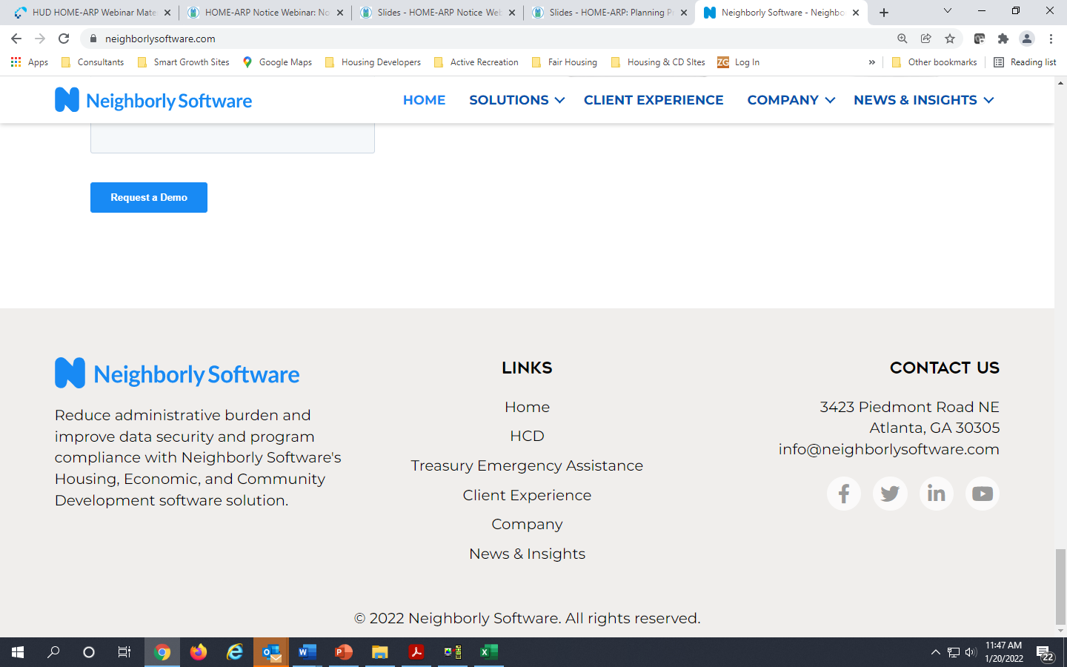
2025 Application Process
NC OCD utilizes an on-line Funding Application platform hosted by
Link to Neighborly Grants Applications
IS EXPECTED TO BE AVAILABLE ON JANUARY 29 AT OCD WEBSITE:
https://www.nassaucountyny.gov/1524/Community-Development
Under “Spotlight” Headings

Slide 56
Public Comment on CDBG and Housing Needs

Slide 57
Nassau County OCD FY 2025 Public Hearing On CD and Housing Needs
Today will begin the public participation process in the development of the:
  Five-Year Consolidated Plan (2025-2029)
  Annual Action Plan for FFY 2025
  Fair Housing Plan/Analysis of Impediments

Slide 58
Public Hearing Schedule
Written comments can be submitted by June 4, 2025
Public Hearing #1 | Needs Hearing | January 28th, 2025
Fair Housing Forum | Fair and Affordable Housing | April 8th, 2025
Public Hearing #2 | Presentation of Proposed Plan | May 13th, 2025

Slide 59

Public Comment
Questions/Comments?
Public comment is requested for:
What are the most significant housing needs in Nassau County?
What Fair and Affordable housing issues do you see in Nassau County?
What are the housing and service needs of the homeless and at-risk of homelessness populations in Nassau County?
What are the needs of those who live in public housing in Nassau County?
What are the housing and service needs of special needs populations in Nassau County?
What are the non-housing, community development needs in Nassau County?

Slide 60
Public Comments
Written comments can be submitted by June 4, 2025
Written Comments can be sent to:
Jeffrey Clark, Executive Director Jclark@nassaucountyny.gov | Donald Crosley, Deputy Director Dcrosley@nassaucountyny.gov
Nassau County Office of Community Development 1 West Street – Suite 365 Mineola, NY 11501

